Slide 1

CS 489/698: Introduction to Natural Language Processing Lecture 1: Introduction & Fundamentals
Instructor: Freda Shi
fhs@uwaterloo.ca
January 5th, 2026

Slide 2
Enrollment
Important for CS698: If you need a permission number to enroll, please stay until the end of this lecture and take a 20-minute quiz.
We have more interest than we can accommodate, so there will be a waitlist.
Your quiz score will determine your waitlist position.
First batch of waitlist will be submitted today.

Slide 3

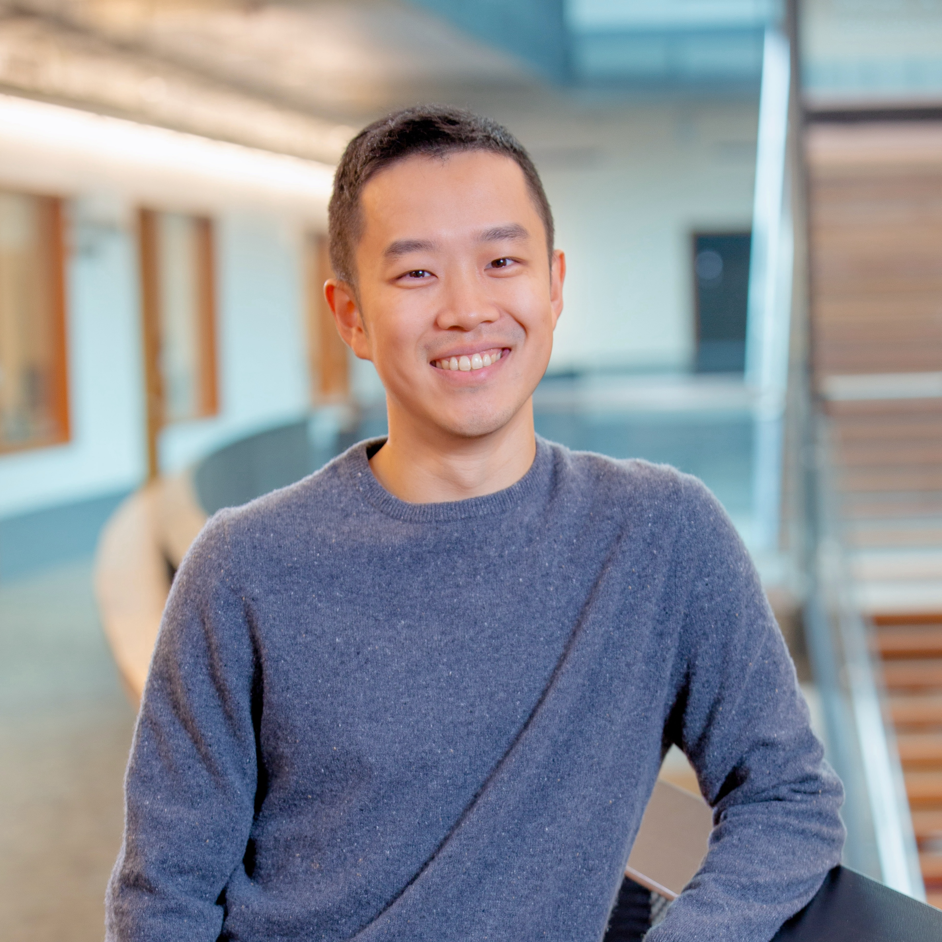
Instructors and Websites
Instructors: Freda Shi (before mid-term) and Victor Zhong (after mid-term)
Office Hours (Freda): Friday 5-6pm until February 11th at DC 2522.
Office Hours (Victor): TBA February 23rd onwards.
Course Website: https://waterloo-nlp.github.io/intro-to-nlp-material
Discussion Forum: https://piazza.com/uwaterloo.ca/winter2026/cs489698
LEARN (for assignments): https://learn.uwaterloo.ca/d2l/home/1220061

Slide 4

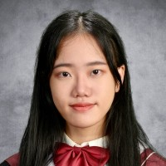


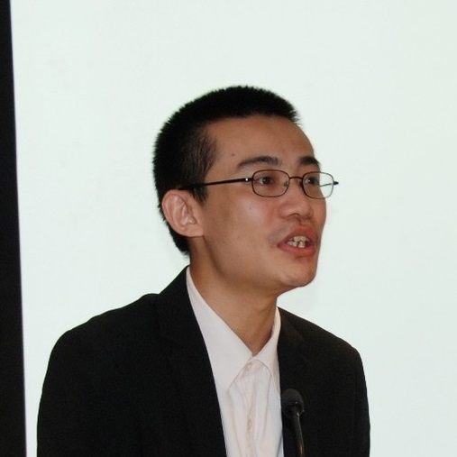
Teaching Assistants
Arthur Chen
haonan.chen@
Kath Choi
ymchoi@
Yifan Jiang
yifan.jiang@
Michael Ogezi
mogezi@
Sheng Yao
s57yao@
TA Office Hours: To be announced before the assignment due dates.

Slide 5
Books
There will be no official textbooks. However, we recommend the following ones for reference:
Jurafsky and Martin, Speech and Language Processing, 3rd edition https://web.stanford.edu/~jurafsky/slp3/
Jacob Eisenstein, Introduction to Natural Language Processing https://cseweb.ucsd.edu/~nnakashole/teaching/eisenstein-nov18.pdf
Yoav Goldberg. A Primer on Neural Network Models for Natural Language Processing https://u.cs.biu.ac.il/~yogo/nnlp.pdf

Slide 6
Grade Breakdown
There will be no exams for this course.
Assignments (50%, 25% each) Due on February 9th and March 2nd, respectively. There will be a major programming practice and some question-answering in each assignment.
Course Project (50% for CS 489, 25% for CS 698) Developing an NLP system for a real-world application. Due on April 6th. Mandatory for passing the course.
Mid-term check-in (10% for CS 489, 5% for CS 698): Due on February 23rd.
Individual Project (25% for CS 698 only) An NLP-related research project of your own choice.
Project proposal: Due on February 23rd. Feedback will be made available in a week.

Slide 7
Lateness Policy
All assignments are due at 11:59 PM Eastern Time (Waterloo time) on the specified due date.
A universal 72-hour grace period applies to all assignment and project dues:
Submissions within the grace period will be accepted without penalty.
No additional extensions will be granted beyond the grace period.
Assignment (excluding the final project) extensions will only be considered in cases of medical emergency, with:
A valid Verification of Illness Form (VIF) submitted, and that
The VIF covers the original due date and the entire grace period.
The extension application must be submitted before the original due date.

Slide 8
GenAI Policy
You may use GenAI tools however you can to assist your learning and growth, but remember these tools can’t be fully trusted and should never replace your own understanding. It is essential to carefully verify the content they generate, especially when working with detailed numbers or using AI to refine your write-ups.
Ultimately, you are fully responsible for the accuracy and integrity of all work you submit in this course.

Slide 9
Collaboration and Citation Policy
Permitted Collaboration: Discussion of assignments with fellow students is encouraged, but all submitted work (including code and written solutions) must be completed independently.
Citation Requirements: All external sources must be properly cited, including
Academic references and literature.
Generative AI tools (e.g., ChatGPT) if used beyond grammar check.
Any other resources consulted during assignment completion.
Student Responsibilities:
Verify the accuracy of any AI-generated content.
Ensure all submitted work reflects your own understanding.
Provide complete and accurate citations for all sources.

Slide 10
Academic Integrity and Intellectual Property
Property of UW:
Lecture content, spoken and written (and any audio/video recording thereof).
Lecture handouts, presentations, and other materials prepared for the course (e.g., PowerPoint slides).
Questions or solution sets from various types of assessments (e.g., assignments, quizzes, tests, final exams).
Work protected by copyright (e.g., any work authored by the instructor or TA or used by the instructor or TA with permission of the copyright owner).
Sharing intellectual property without the intellectual property owner’s permission is a violation of intellectual property rights.

Slide 11
Should I take the course?
You will find the course helpful if
You are curious about the fundamentals and detailed implementations of language models.
You are looking to apply state-of-the-art NLP techniques to your own goals.
You are interested in NLP and computational linguistics research.
This course will not cover
Basics of Python programming, probability, and algorithms.
System and architectures for efficient language model training and deployment.
GPU programming (except for a few high-level basics).

Slide 12
Prerequisites
The formal prerequisite for this course is to ensure you have sufficient mathematical and programming maturity.
The following background knowledge is strongly recommended:
Basic knowledge of calculus, linear algebra, and probability.
Python programming proficiency.
Fundamentals of algorithms, e.g., basic complexity analysis.
Understanding of basic data structures, e.g., lists, stacks, queues, trees, and graphs.

Slide 13
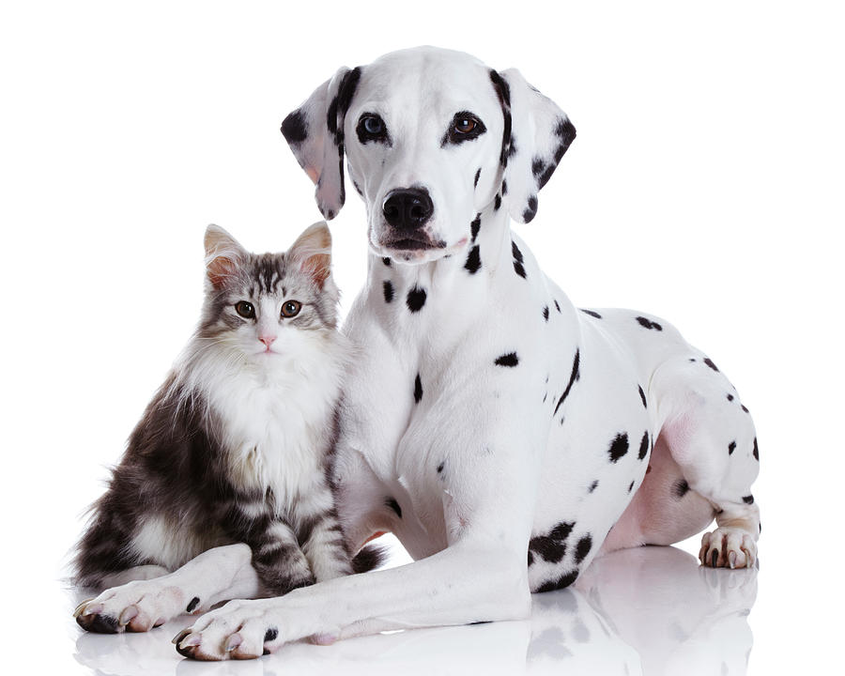
What is Natural Language Processing (NLP)?
A cat is sitting next to a dax.
Q: What is a dax?
Goal: understand natural language with computational models.
End systems that we want to build:
Simple: Text classification, grammatical error correction, …
Complex: Translation, question answering, speech recognition, …
Unknown: Human-level comprehension (is this just NLP?)
Notes:
We compose the meanings of unknown words by making use of the known words.

Slide 14
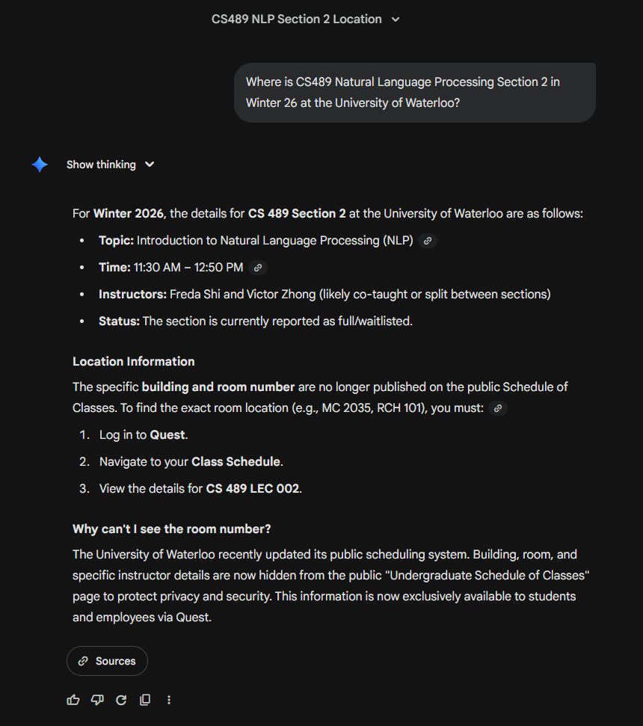
Notes:
An immediate application we can think about within NLP is a general-purpose chatbot, such as ChatGPT and Gemini.

Slide 15
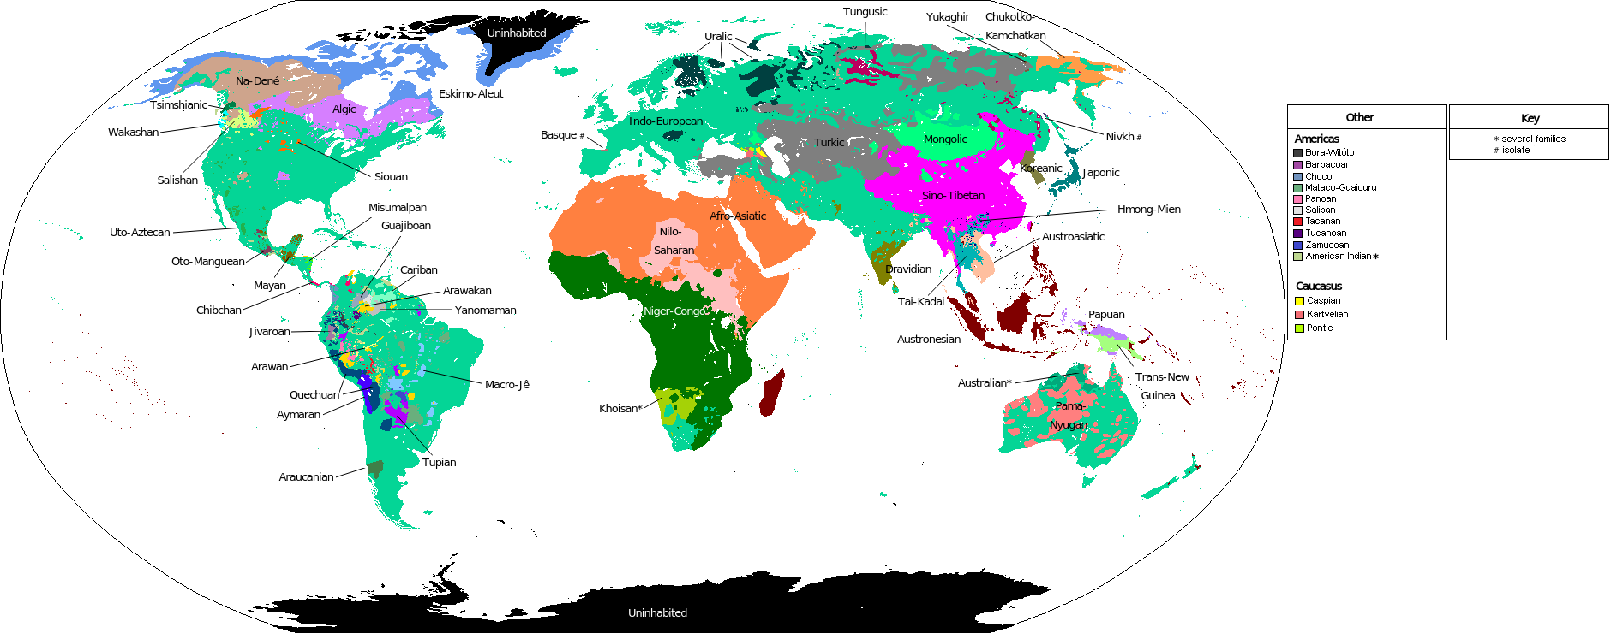

Slide 16
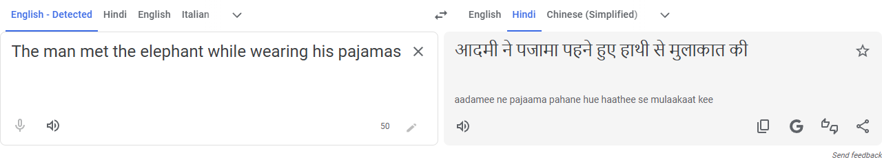
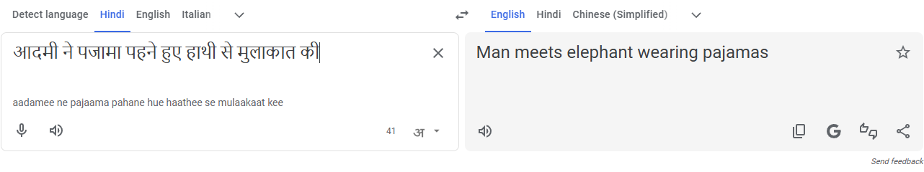
Machine Translation
[Google Translation 2025-12]

Slide 17
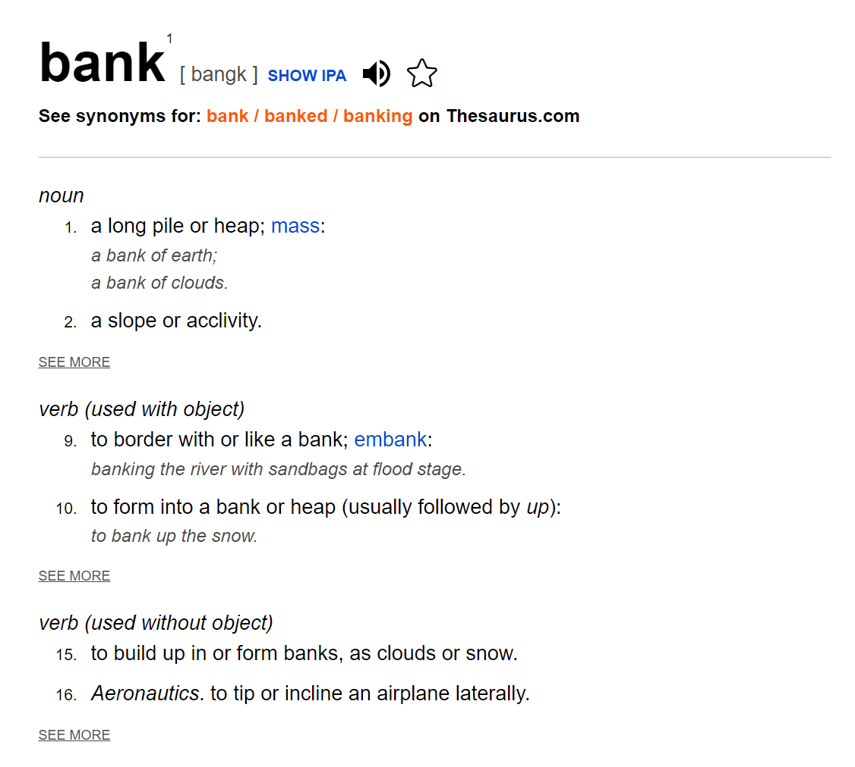
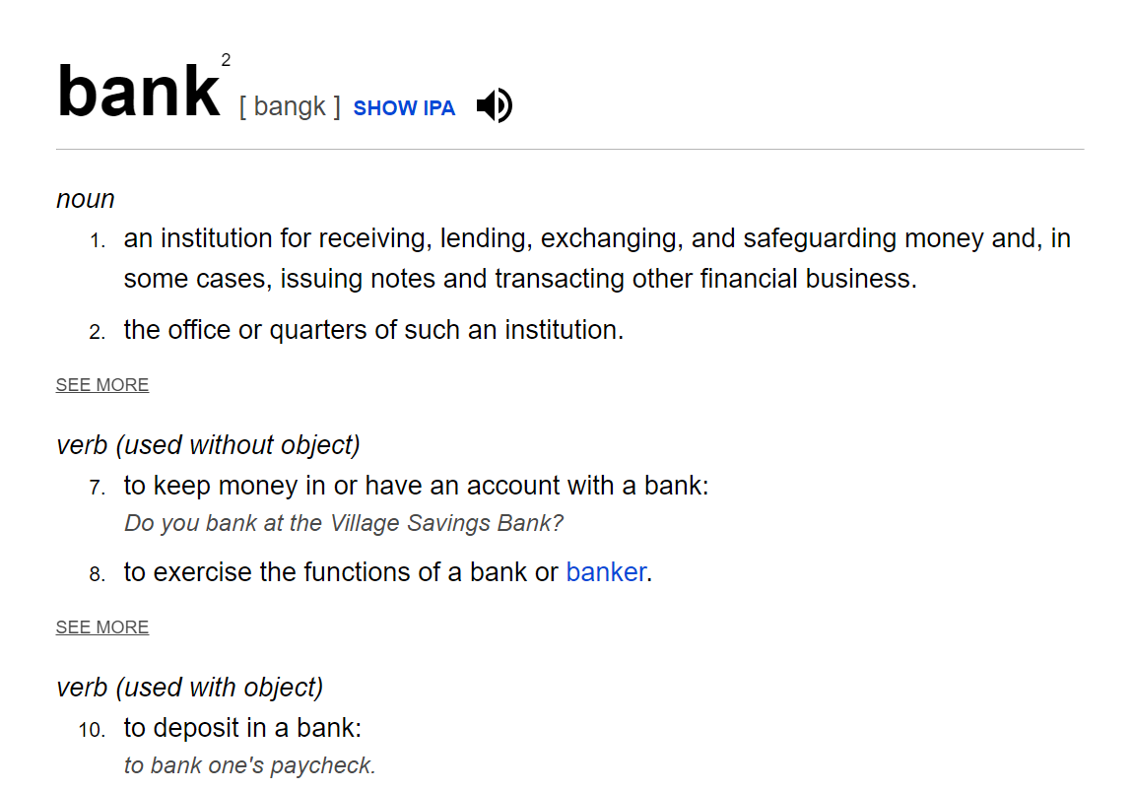
Why is NLP difficult?
Ambiguity: one form can have multiple meanings.

Slide 18


Why is NLP difficult?
Ambiguity: one form can have multiple meanings.
She saw a cat with a telescope.
Who was with a telescope?
[Images generated with Nano Banana Pro]

Slide 19
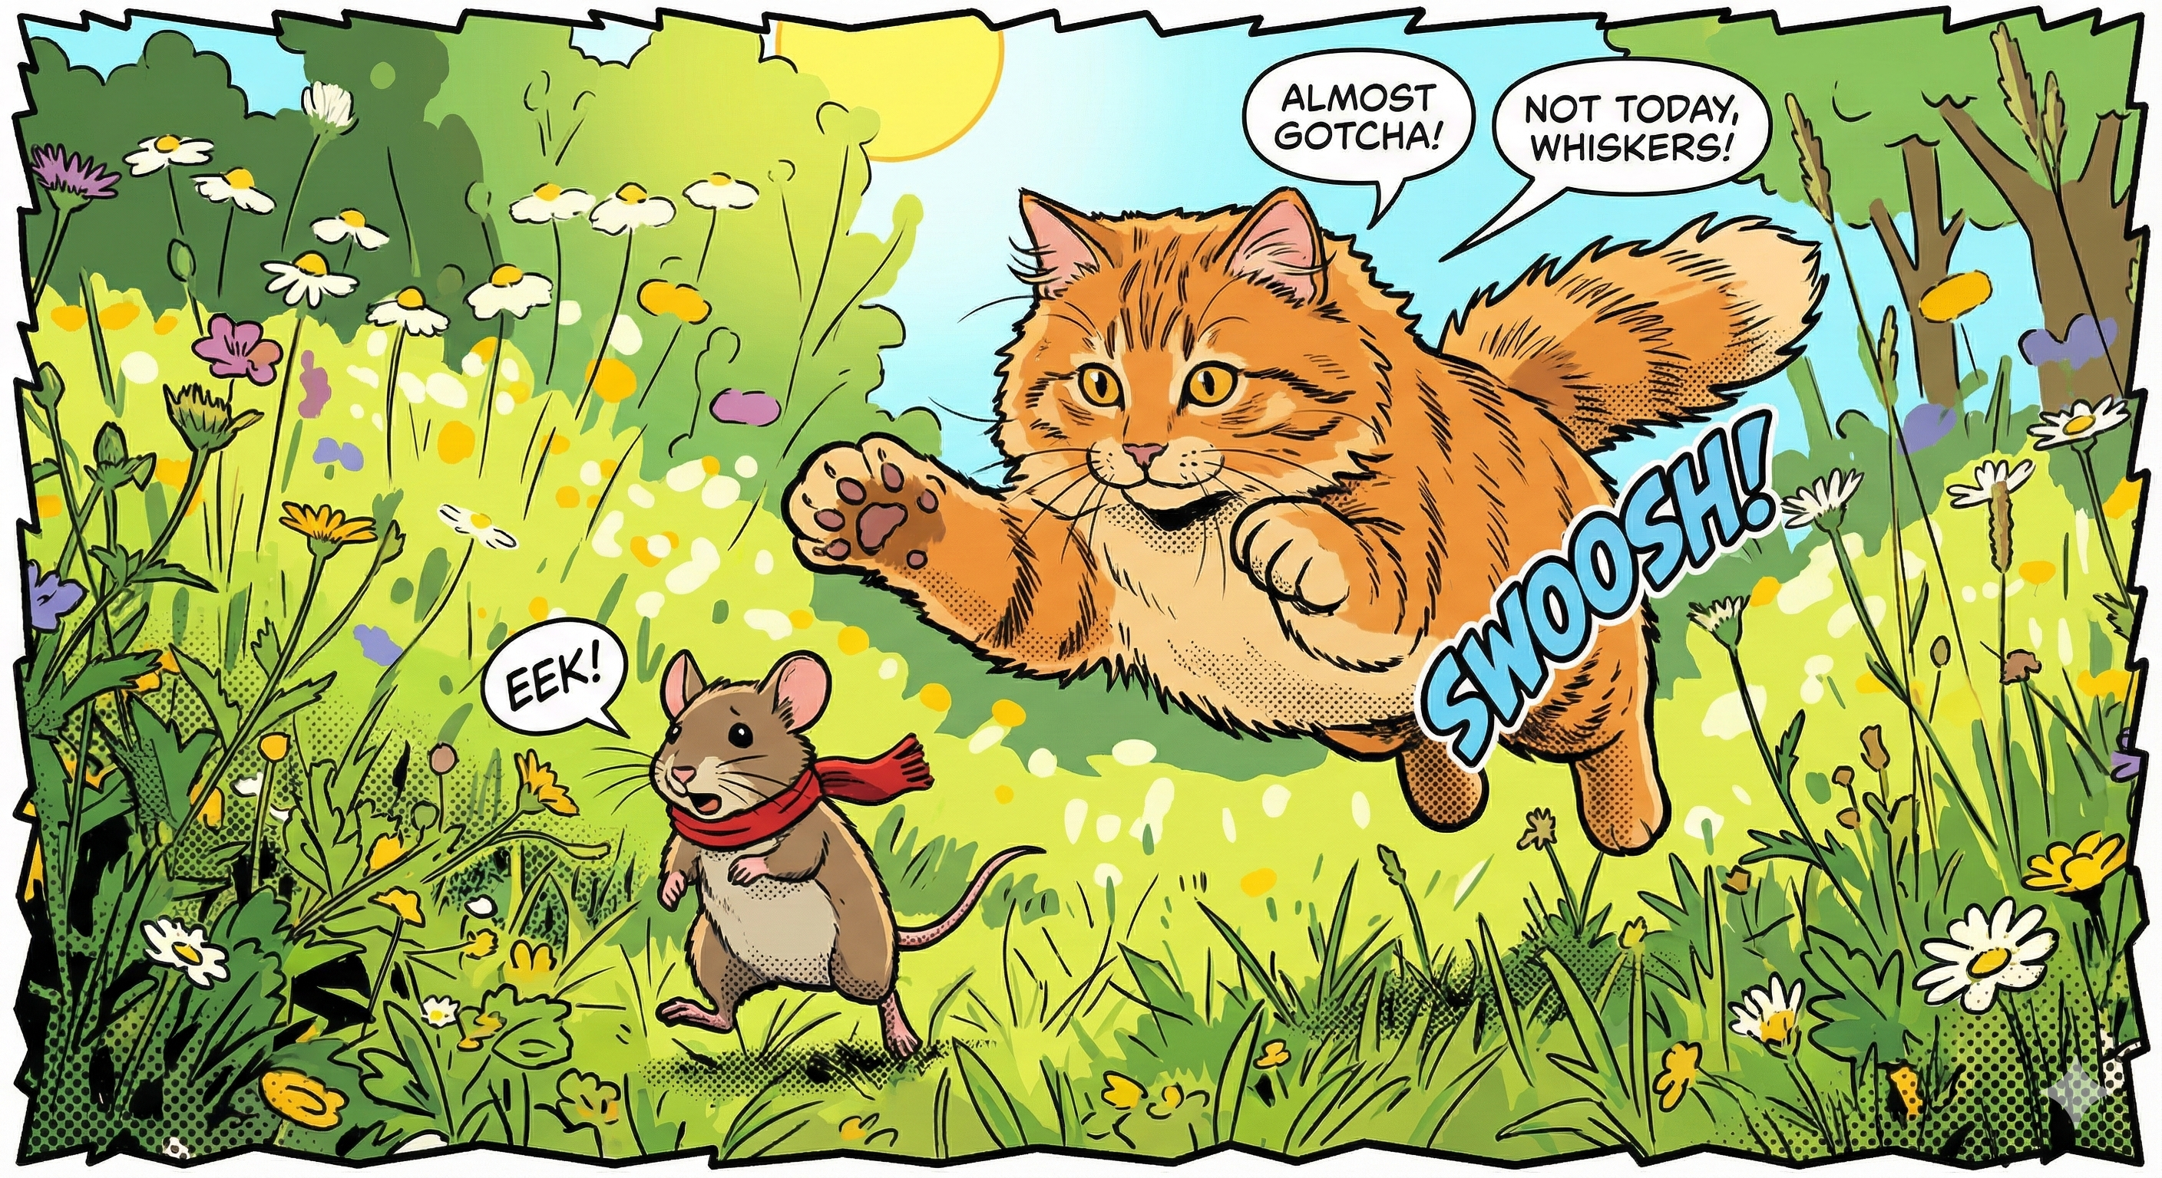
Why is NLP difficult?
Ambiguity: one form can have multiple meanings.
Variability: multiple forms can share the same meaning.
The cat is chasing the mouse.
The mouse is being chased by the cat.
[Image generated with Nano Banana Pro]

Slide 20
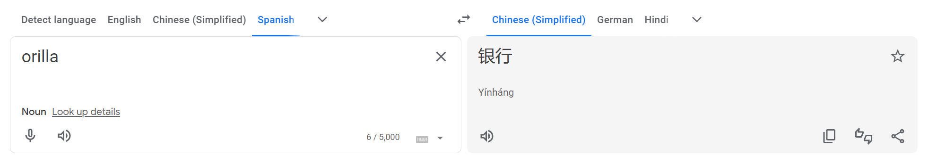


Why is NLP difficult?
Ambiguity: one form can have multiple meanings.
Variability: multiple forms can share the same meaning.
Cross-lingual awareness, dialects, and accents.
[https://translate.google.com, queried on 01/01/2026]
Chinese (Simplified): 岸
Spanish: banco

Slide 21
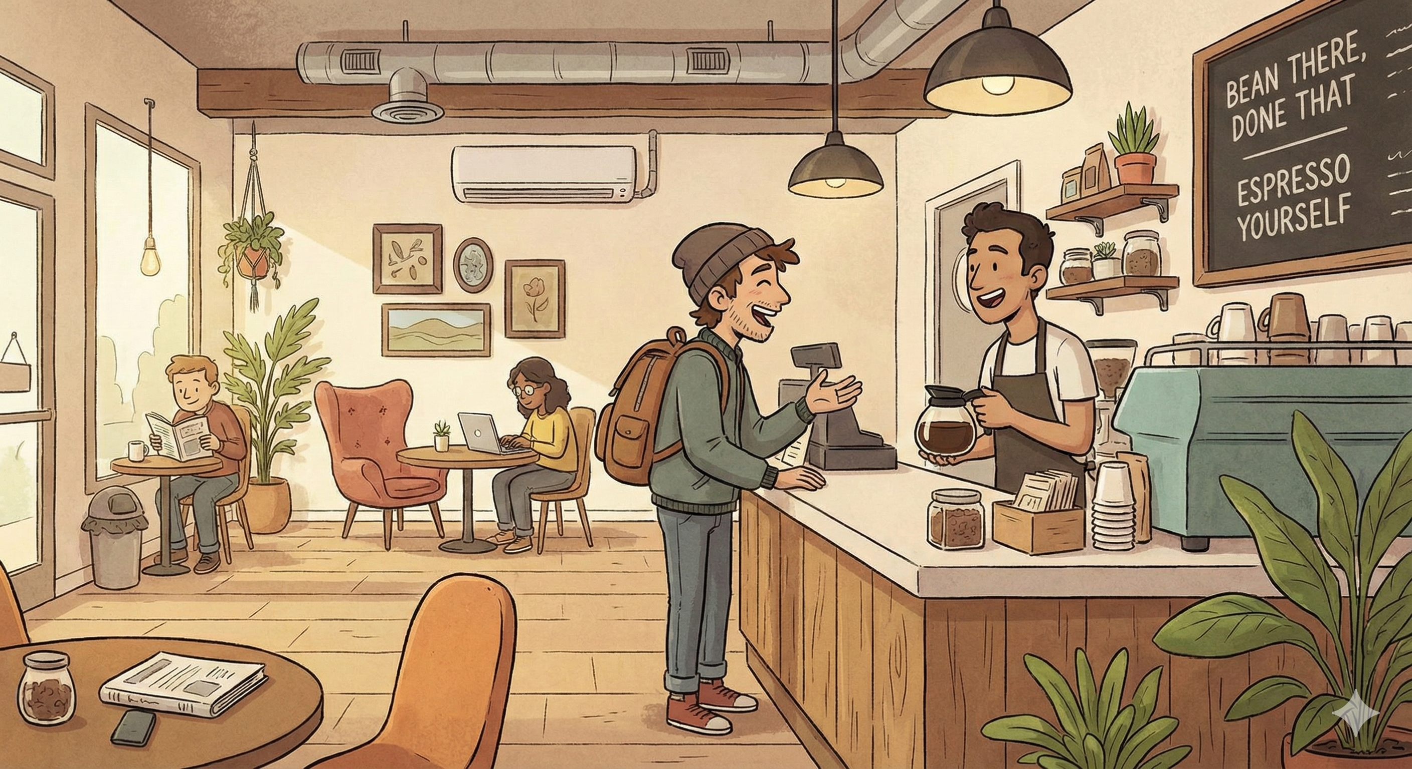
Why is NLP difficult?
Ambiguity: one form can have multiple meanings.
Variability: multiple forms can share the same meaning.
Cross-lingual awareness, dialects, and accents.
Underlying meanings: politeness, humor, irony.
Q: Do you have iced tea?
A1: No.
A2: We have iced coffee.
[Image generated with Nano Banana Pro]

Slide 22
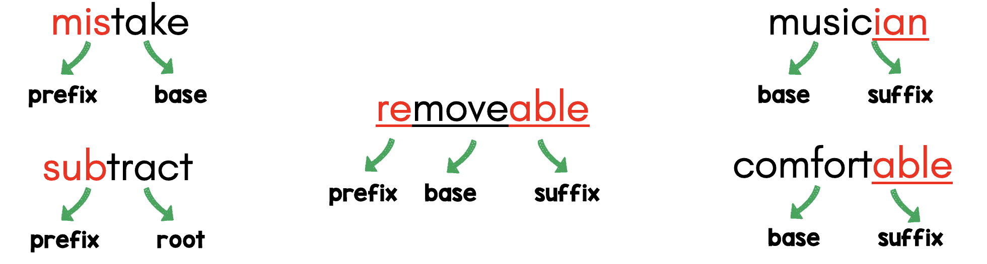
Roadmap: Levels of Language
Morphology: What words/subwords are we dealing with?

Slide 23
Roadmap: Levels of Language
Morphology: What words/subwords are we dealing with?
Syntax: What phrases are we dealing with?

Slide 24

Roadmap: Levels of Language
Morphology: What words/subwords are we dealing with?
Syntax: What phrases are we dealing with?
Semantics: What is the literal meaning?
What an excellent weather!

Slide 25

Roadmap: Levels of Language
Morphology: What words/subwords are we dealing with?
Syntax: What phrases are we dealing with?
Semantics: What is the literal meaning?
Pragmatics: What is the underlying meaning?
What an excellent weather!

Slide 26
Roadmap: Modeling Approaches
Classification
Sentiment Classifier
It’s a cute cat!
positive
It’s a cute cat!
Logical Consistency Checker
False
It’s a dog.

Slide 27
Roadmap: Modeling Approaches
Classification
Language modeling
Next-Word Predictor
GPT
It’s a cute
cat
[Mask] Token Predictor
BERT
It’s a [mask] cat
cute

Slide 28
Roadmap: Modeling Approaches
Classification
Language modeling
Sequence-to-Sequence modeling
It’s a cute cat
Translator
Es ist eine süße Katze
It’s a cute cat with a beautiful long tail.
Simplifier
It’s a cute cat.

Slide 29
Brief History of NLP
1960s-1990s: Classical NLP
Linguistic theories
Manually-defined rules
Small-scale datasets and experiments
2012-now: Neural NLP
Neural network as primary architecture
Learning representations from large corpora
Less hand-crafting features/linguistic knowledge
1980s-2013: Statistical NLP
Supervised machine learning with annotated data
(Mostly) linear models with manually-defined features
Linguistic knowledge used in annotation
2022-now: Large language models
Pretrain a language model
Use the pretrained language model for various tasks

Slide 30
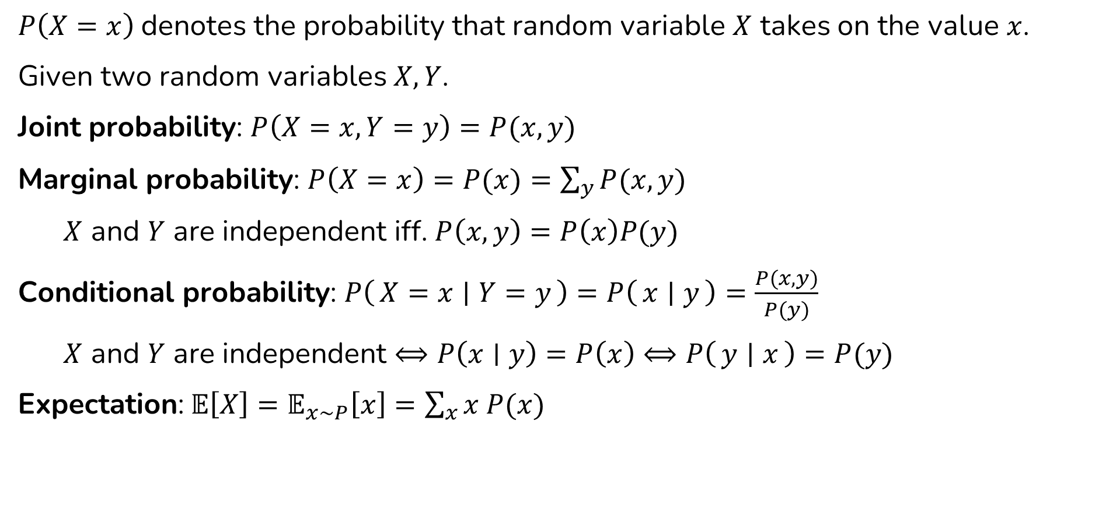
Common Notations of (Discrete) Probability
$P\left(X=x\right)$denotes the probability that random variable $X$ takes on the value $x$.
Given two random variables $X, Y$.
Joint probability: $P\left(X=x, Y=y\right)=P(x, y)$
Marginal probability: $P\left(X=x\right)=P(x)=\sum_{y}{P(x,y)}$
$X$ and $Y$ are independent iff. $P\left(x,y\right)=P\left(x\right)P(y)$
Conditional probability: $P\left(X=x ∣ Y=y\right)=P\left(x ∣ y\right)=\frac{P(x, y)}{P(y)}$
$X$ and $Y$ are independent $⟺P\left(x∣y\right)=P\left(x\right)⟺P\left(y ∣ x\right)=P(y)$
Expectation:$𝔼\left[X\right]=𝔼_{x\sim P}\left[x\right]=\sum_{x}{x P(x)}$

Slide 31
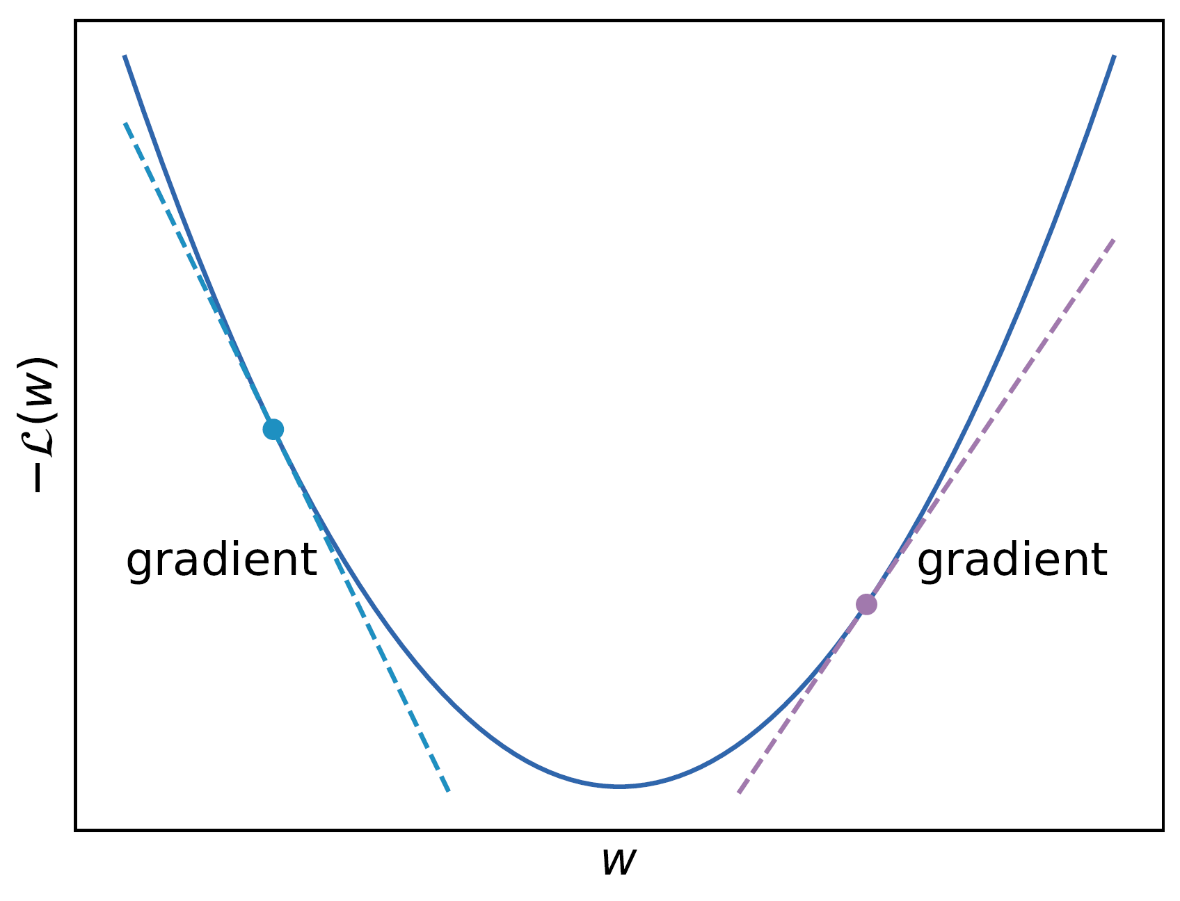
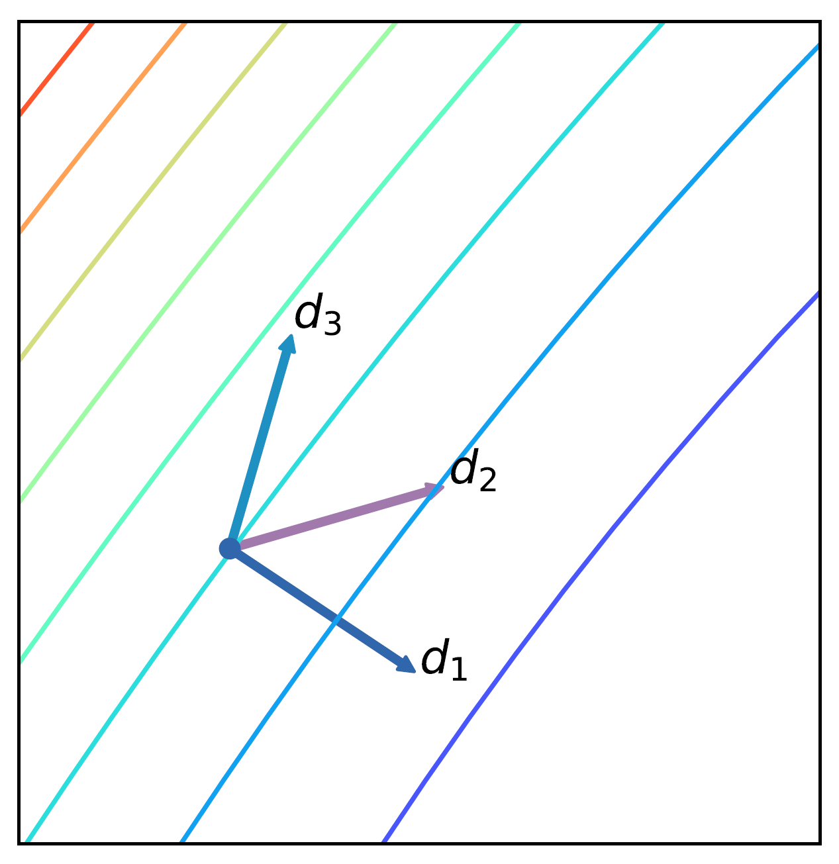
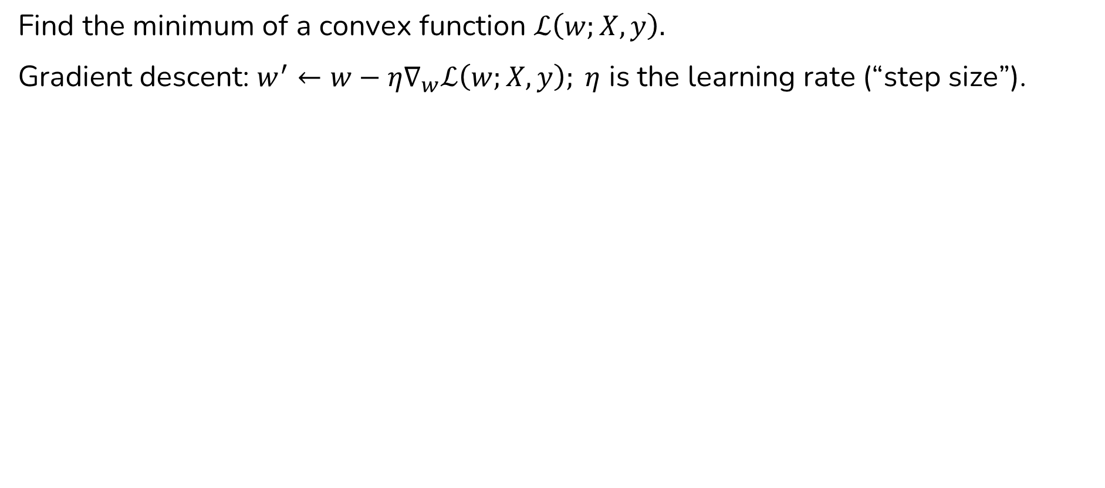
Finding the Optimum of a Function
Find the minimum of a convex function $ℒ\left(w;X, y\right).$
Gradient descent: $w^{′}←w−η∇_{w}ℒ\left(w;X, y\right); η$ is the learning rate (“step size”).

Slide 32
Next
Morphology, tokenization, word, subwords

